Slide 1
Intro to Programming Part 4: modeling and simulations
Keisuke Ishihara

Slide 2
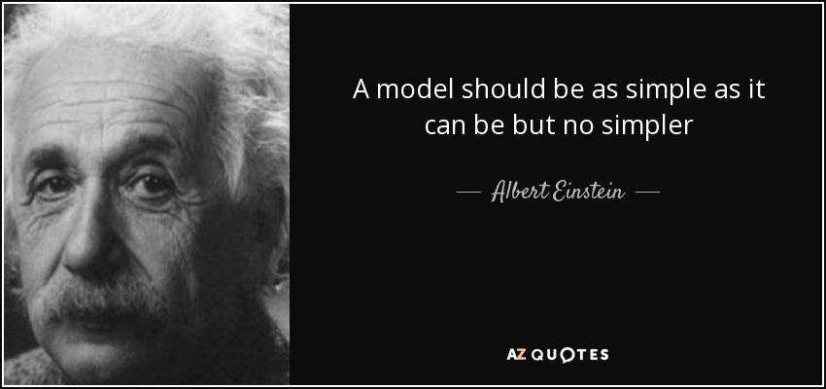
What is a model?
"Our simplified yet useful representation of reality."
Predict the future.
Predict different outcomes.
“Modeling”: To build, analyze, test, and critique models (of biology).
Gunawardena, J. Models in biology: ‘accurate descriptions of our pathetic thinking’. BMC Biol 12, 29 (2014). https://doi.org/10.1186/1741-7007-12-29

Slide 3
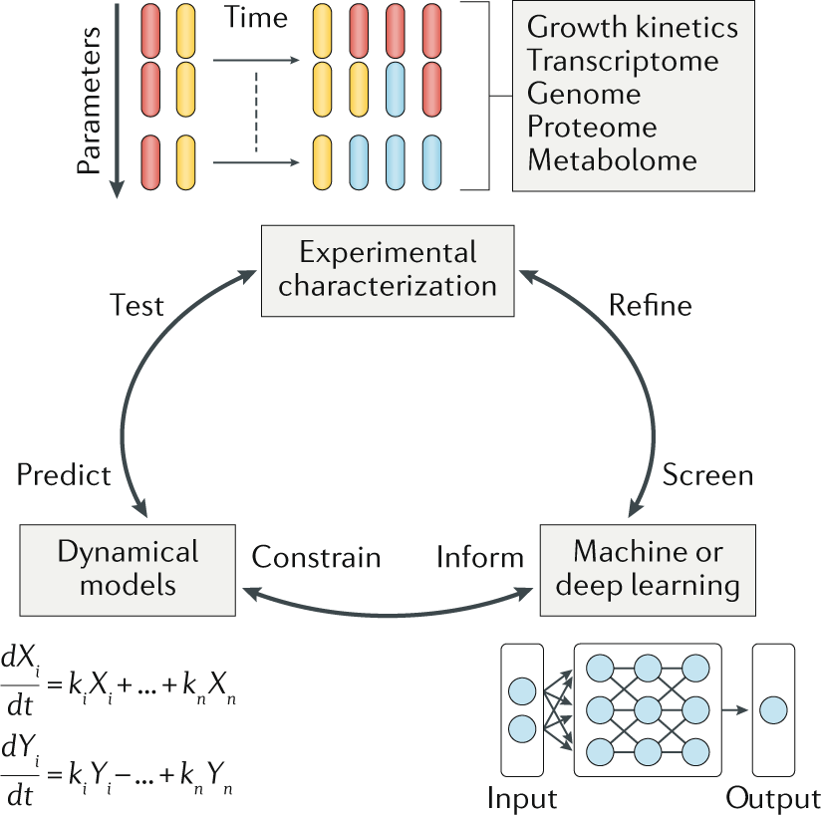
Experiments
+
Physical models
+
Machine learning models
Physical
Models
Lopatkin, A.J., Collins, J.J. Predictive biology: modelling, understanding and harnessing microbial complexity. Nat Rev Microbiol 18, 507–520 (2020). https://doi.org/10.1038/s41579-020-0372-5

Slide 4
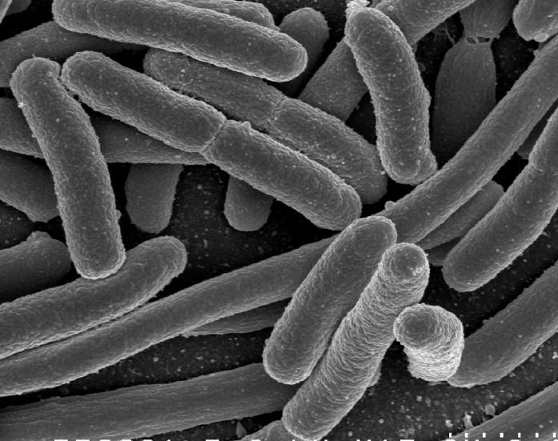
A simple growth model: Bacterial cells divide every 20 min Starting from one cell, how many cells in 4 hours?

Slide 5
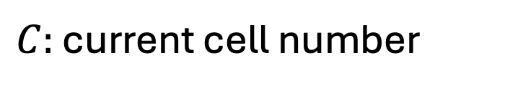
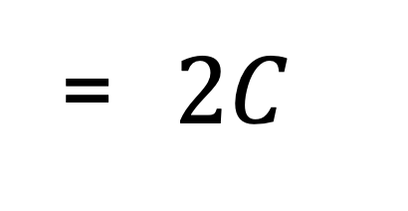
Doubling every 20 minutes is a “chain reaction”
Time [min] | Generation | Nr. of cells N
0 | 1 | 1
20 | 2 | 2
40 | 3 | 4
60 | 4 | 8
Cell number in
next generation
= $2C$
$C:$ current cell number

Slide 6
Predicting the number of cells vs. time 1. using Google Spreadsheets 2. using Python and for loops

Slide 7
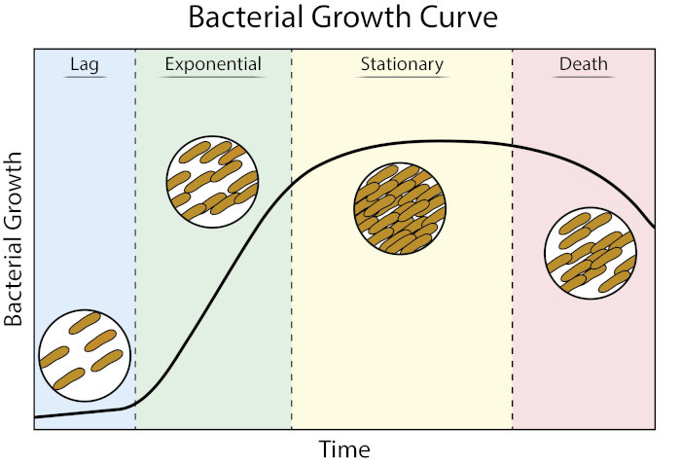
Bacterial division leads to exponential growth
Until resources are consumed…
Bonus Q:
How can you model resource consumption?
Log(Cell number)
JoVE Science Education Database. Microbiology. Growth Curves: Generating Growth Curves Using Colony Forming Units and Optical Density Measurements. JoVE, Cambridge, MA, (2023).

Slide 8
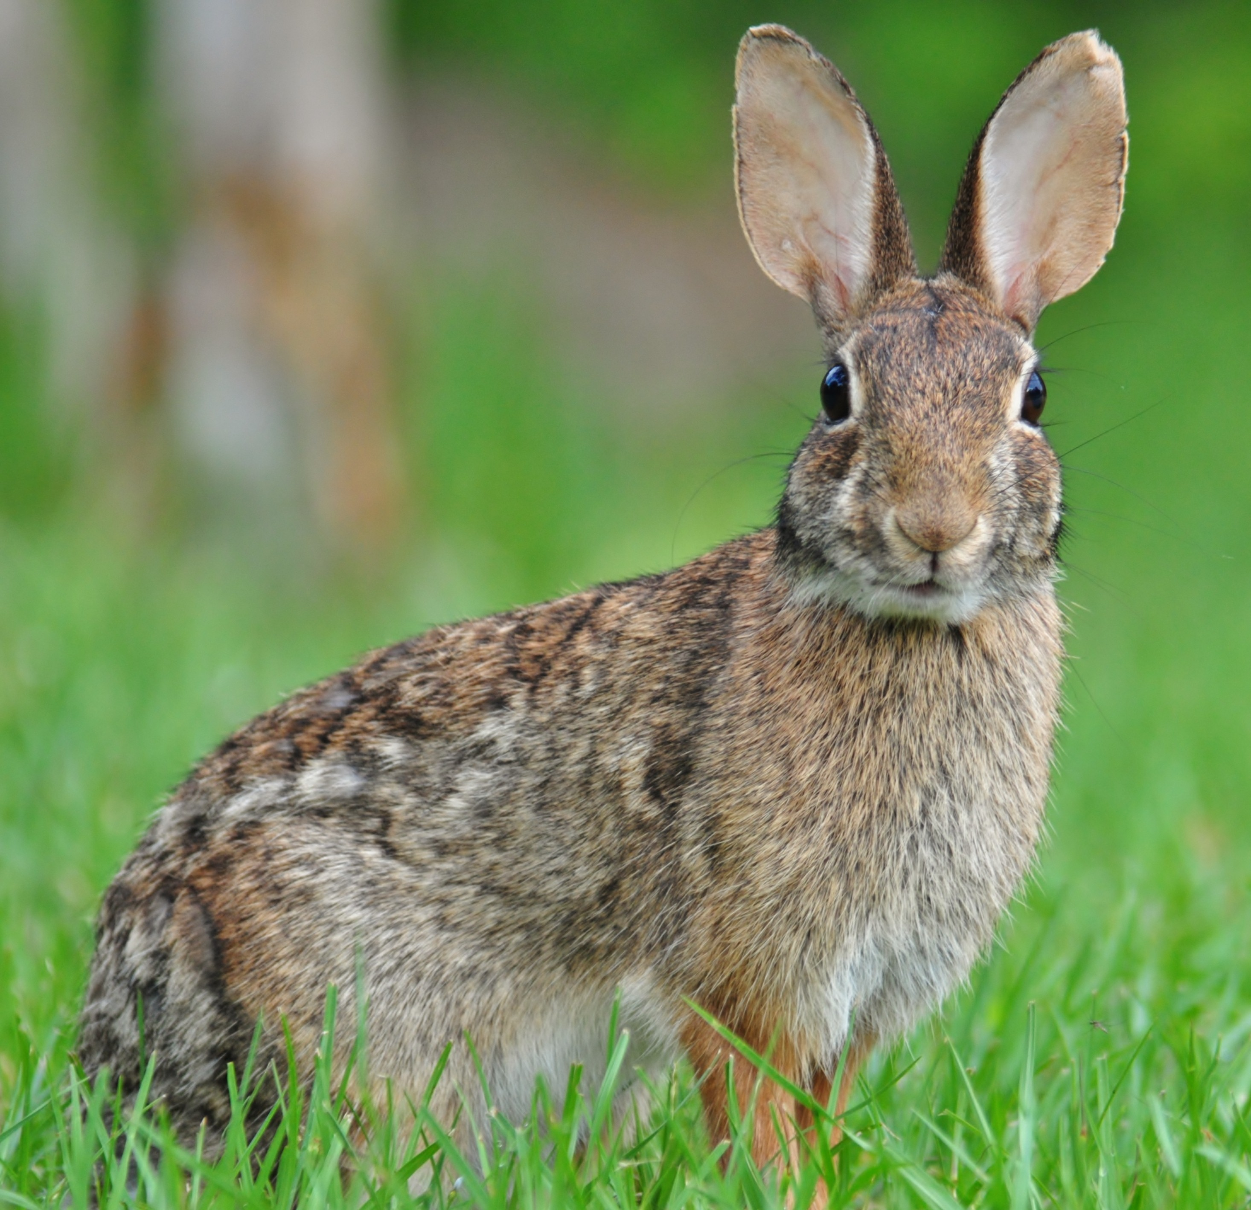
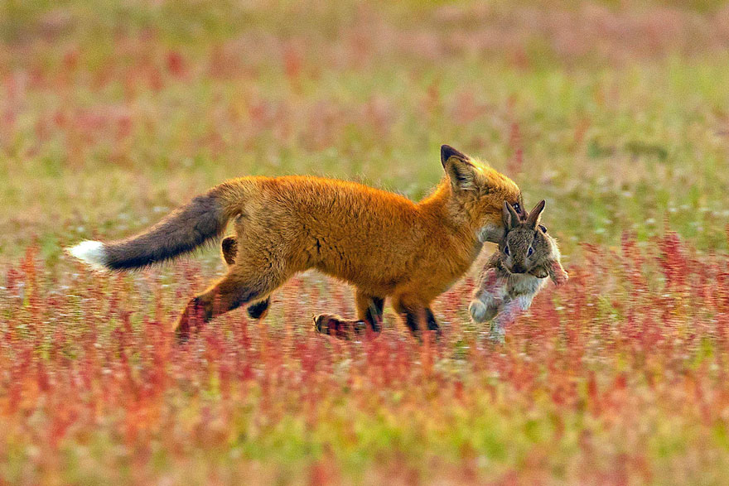
1. Rabbits multiply. 2. Fox feed on rabbits.
Mathematical ecology:
Modeling the population dynamics of rabbits and foxes

Slide 9

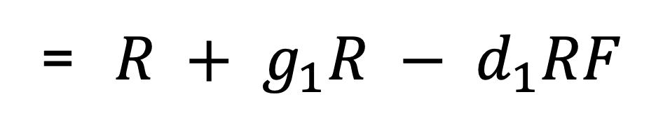

Modeling the Rabbit-Fox interactions
Rabbit pop. in
next generation
= $R + g_{1}R − d_{1}RF$
Current
Rabbit growth
Rabbit death
$$g_{1}:$$
Growth rate of rabbits
$$g_{2}:$$
Growth rate of foxes

Slide 10
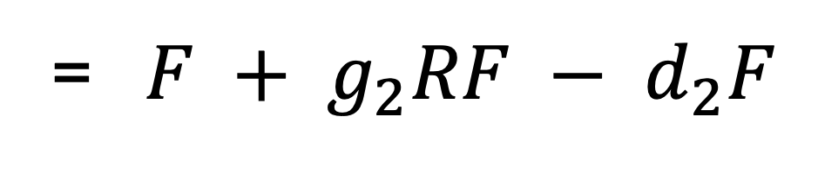


Modeling the Rabbit-Fox interactions
Rabbit pop. in
next generation
= $R + g_{1}R − d_{1}RF$
Rabbit growth
Rabbit death
Fox pop. in
next generation
= $F + g_{2}RF − d_{2}F$
Fox growth
Fox death
$$g_{1}:$$
Growth rate of rabbits
$$d_{1}:$$
Death rate of rabbits
$$g_{2}:$$
Growth rate of foxes
$$d_{2}:$$
Death rate of foxes

Slide 11
Predicting the population dynamics of rabbits and foxes 1. using Google Spreadsheets 2. using Python and for loops

Slide 12
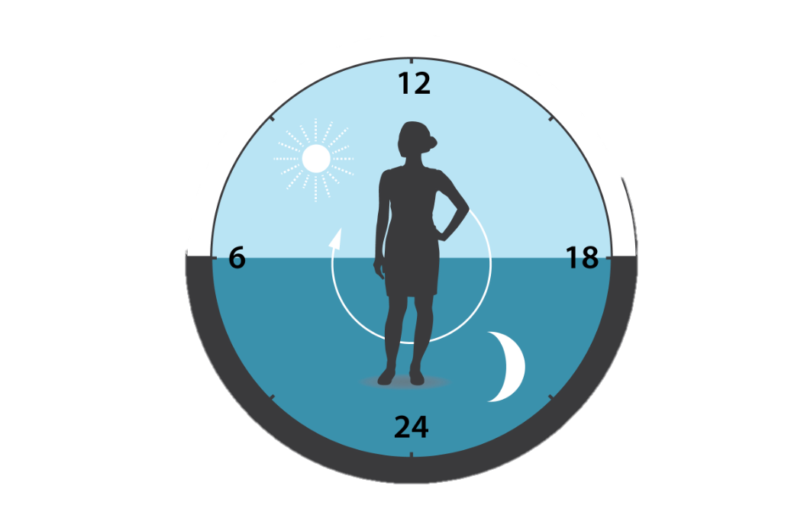
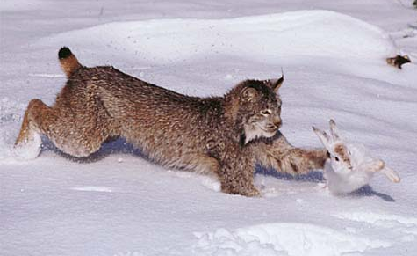
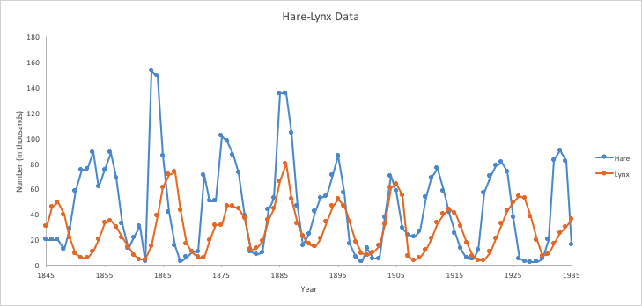
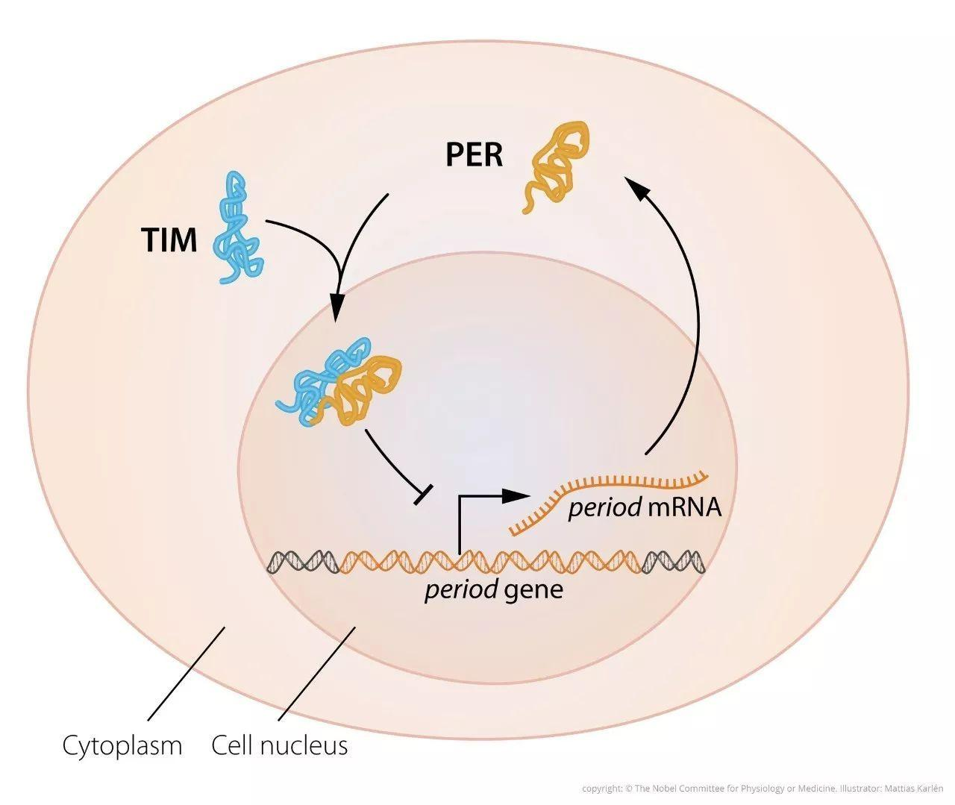
Modeling oscillations in the field and in our bodies
Circadian clock
~24 hours
Hare and Lynx
https://www2.nau.edu/lrm22/lessons/predator_prey/predator_prey.html
www.nobelprize.org

